Slide 1
APIGEE

Slide 2
Introduction to APIGEE
By taking advantage of major transitions in apps and platforms, lining your business up with the new value chain, and getting into the API business and doing it well, you'll see unprecedented levels of reach, new channels of revenue, while at the same time doing a better job of maintaining your people, time, and costs.
APIGEE Provides Gateway Services, App Services, Analytics Services, Developer Channel Services.

Slide 3
Apigee API Platform: How it works
Apigee gives you a complete solution to create new customer reach, innovation, and business value through APIs and apps.
Transform your existing services into beautifully designed APIs.
Enable developers to build innovative, engaging apps.
Drive developer adoption and community.
Extract business value from your API and app ecosystem.

Slide 4
SAP Access: Enabling Mobile Apps to Consume Services from an ERP Backend
By using APIGEE product We can get the data from ERP. The Apigee Platform to expose a standard SAP backend and convert a JSON request into a SOAP SAP back-end request.
APIGEE Product Provides facilities with no coding and taking advantage of capabilities like XSLT, you can make it possible for mobile apps to consume services from an ERP backend system.
SAP provides a few options for exposure of services including:
Using a mediated SAP PI/XI integration server
Using a web service where the web service client accesses APIs that have been exposed.

Slide 5
SAP Access: Enabling Mobile Apps to Consume Services from an ERP Backend
Exposing a single SOAP service that you can consume via a web service or an app.
Apigee enables multiple devices to consume and convert SOAP XML responses to RESTful JSON, which is lightweight for mobile device consumption.

Slide 6
Telco APIs: ParlayX-to-OneAPI SOAP-to-REST Transformation
Apigee enables a transformation that can typically be a complex example in a Telco environment - A Telco XML/SOAP style backend (ParlayX) converted to the GSMA OneAPI.
Telco carriers have a plethora of back-end IT services including accounting, billing, provisioning, and so on. They have network services including voice, data, messaging, speech, location . . .as well as new cloud services around compute and storage, and so on. communication, SOAP to REST, and REST to SOAP policies

Slide 7
Telco APIs: ParlayX-to-OneAPI SOAP-to-REST Transformation
A middleware layer in the telco architecture takes the Location Based Services (LBS) and Short Message Service Center (SMSC) (the portion of a wireless network that handles SMS operations) and exposes them - typically as a ParlayX type interface.
GSMA, together with major operators, has developed a RESTful API - OneAPI - to facilitate and significantly reduce the time it takes to develop apps that make use of mobile networks’ capabilities. Apigee, as part of the access and exposure layer in Telco architectures, allows carriers to use the existing back-end infrastructure and expose new flavors of APIs.

Slide 8
Telco APIs: ParlayX-to-OneAPI SOAP-to-REST Transformation
Use of CORS policies for cross-domain
e.g.
<filter><filter-name>CorsFilter</filter-name>
<filter-class>org.apache.catalina.filters.CorsFilter</filter-class>
<init-param>
<param-name>cors.allowed.methods</param-name>
<param-value>GET</param-value>
</init-param>
</filter>
<filter-mapping>
<filter-name>CorsFilter</filter-name>
<url-pattern>/*</url-pattern>
</filter-mapping>

Slide 9
Telco APIs: ParlayX-to-OneAPI SOAP-to-REST Transformation
This enables carriers to create their own location or messaging APIs on top without having to go into the middleware layer meaning faster time to market for new services and avoids introducing instability in an operational network.
Apigee enables SOAPO to REST and REST to SOAP transformations in a Telco environment, including:
A simple GSMA OneAPI-based request
A REST to SOAP transformation to rewrite the target URL to talk to the ParlayX back-end system
Backend returns ParlayX response and Apigee transforms from SOAP to REST
Extraction of variables from ParlayX and construct a RESTful JSON - style payload

Slide 10
Migrating Customers Easily to Your Cloud Services: Transformations & the API Platform
Companies want to expose cloud service with security, control and visibility, but also find the need to expose existing cloud service using alternative API flavors. Doing transformations between API flavors makes APIs consumable and appealing to customers and partners and makes it easy for them to migrate to a company's cloud service.
Apigee describes Apigee's API Platform, how it's used to expose cloud services, making consumable APIs that appeal to customers and partners. Apigee easily enables implementation of cloud API transformations - doing an OpenStack to VMWare transformation, applying policies on the request and response paths, using JPath to extract variables and assign messages, and using the Trace tool to see what's happening.

Slide 11
Apigee API Platform: Gateway Services
Greg Brail introduces Gateway Services - a component of the Apigee API Platform. Create, manage and scale APIs that app developers will love with Gateway Services. Transform any data feed, web service, or 3rd party API into robust, intuitive APIs.
Apigee gives you a complete API platform for the app economy. The API platform includes Gateway Services, App Services, Developer Channel Services, and Analytics Services

Slide 12
Apigee API Platform: Developer Channel Services
Jen Mazzon introduces Developer Channel Services - a component of the Apigee API Platform. Developer Channel Services enable you to get developers up and running quickly. Make a good first impression, increase developer adoption, and build community with a complete portal that offers frictionless on-boarding and interactive API documentation.
Apigee gives you a complete API platform for the app economy. The API platform includes Gateway Services, App Services, Developer Channel Services, and Analytics Services

Slide 13
APP SERVICES

Slide 14
What is App Services?
App Services is a backend-as-a-service (BaaS) solution that enables you to quickly integrate valuable features into your app, including social graphs, user management, data storage, push notifications, performance monitoring, and more.
Using App Services, you can set up development needed your own cloud-based data platform in minutes instead of months – no server-side coding or back-end.
This allows your team to focus on developing the rich features and user experience that truly differentiate your app, rather than the time-consuming details of implementing core back-end services and infrastructure.

Slide 15
App Services Features
Data Storage and Management
Application Data - At the core of App Services is a flexible platform that can store any type of application data, from simple records like a catalog of books to complex associations like user relationships .
Files & assets - Images, video, and audio are key components of a great app experience. With App Services, you can upload and retrieve binary objects from the same data store as the rest of your application data, eliminating the need to set up content delivery networks (CDNs) and easing implementation.

Slide 16
AppServices Features
Flexible data querying - One of App Services' most powerful features is the ability to perform SQL-style queries and full-text searches on data entities, as well as their properties. This lets you quickly retrieve specific data entities based on multiple criteria, then utilize that data to power social features, target push notifications, perform user analysis, and more.
Social - Entity Relationships - With App Services you can create relationships between data entities to help build features, improve user experience, and contextualize data.

Slide 17
AppServices Features
Activity Streams - A key aspect of social networking apps is the ability to provide and publish data streams of user actions, such as ongoing lists of comments, activities, and tweets. App Services simplifies management and routing of these data streams by providing an activity entity that is specifically designed to automatically create a relationship between activities and the user who created them

Slide 18
AppServices Features
User Management
Registration and login - App Services makes it easy to add and manage users by providing the core services necessary to handle secure registration and log in, including OAuth 2.0-compliant client authentication. In addition, any number of default or custom data entities and properties can be associated with a user entity to create complete user profiles.
Roles and Permissions - Applications often require the ability to configure fine-grain control of user access to data, features and functionality. App Services solves the implementation details of user access with roles and permissions.

Slide 19
AppServices Features
Groups - Groups are a flexible way to organize your users based on any number of criteria. For example, you might group users based on interests or location to more effectively deliver relevant content, target offers, or customize campaigns.
Third-Party Authentication - In addition to supporting user management and OAuth-based login for your app, App Services also makes it easy to integrate third-party authentication through such popular services as Facebook, Twitter and other OAuth-enabled accounts.

Slide 20
AppServices Features
Geolocations
The App Services device entity allows you to capture geolocation data from your users' GPS-enabled devices to more effectively target campaigns, push notifications, offers and more. Geolocation also gives you an important data point for contextualizing and analyzing trends and user behavior.

Slide 21
AppServices Features
Push Notifications
Push notifications are the most effective way to engage your users with relevant content, and thanks to App Services, implementing them can be done in minutes. Simply register your app and your user's devices with a notification provider, such as Apple Push Notification Service or Google Cloud Messaging, then use the App Services notification entity to send millions of push notifications a month at no cost

Slide 22
AppServices Features
Configuration Management
By giving you the ability to push configuration changes directly to users' devices, App Services lets you test and deliver bug fixes and performance improvements in real time. Remote configuration management can even be used to push changes to a subset of all users, enabling A/B testing of fixes, so that you can monitor and collect data to ensure your updates perform as intended before they are pushed to your entire user base.

Slide 23
App Services Features
Error and Performance Monitoring
One of the largest barriers to the success of an app can be the ability of developers to respond quickly and precisely to performance issues and bugs. App Services includes data logging and visualization tools that let you monitor and analyze network performance, usage patterns, crash statistics and other key metrics, giving you the data necessary to quickly manage performance issues as they arise.

Slide 24
App Services Data Model
App Services models the data for your apps as application-specific collections of data entities managed within an organization. The following is an overview of the component hierarchy that makes up the App Services data model, and is intended to help you understand how data is stored, managed and accessed in App Services.
Organizations
An organization contains one or more applications, and represents administrator-level access to App Services. Multiple App Services accounts may be given administrator access to an organization. App Services accounts can also be members of multiple organizations.

Slide 25
AppServices Data Model
Applications
In App Services, you can create one or more applications within an organization. Applications represent an instance of application data associated with an app, and you may create as many applications as you wish. This allows you to utilize the App Services backend in a way that corresponds to your development process.

Slide 26
AppServices Data Model
Properties
A data entity is a set of properties, which can each contain any JSON-representable value, including a nested JSON document. All entities have predefined properties, but you are free to define any number of custom properties for any entity. Default properties require specific data types for validation purposes, while custom properties can be any JSON data type. Most predefined and all application-defined entity properties are indexed, allowing you to query collections quickly and easily.

Slide 27
Collections
Collections
App Services stores all data entities in uniquely-named collections. Collections are created automatically by App Services for every entity type, including custom entities, and are named using the plural form of the entity type they store.
In App Services, all entities are automatically associated with a corresponding collection based on the type property of the entity. You may create empty collections if you wish, but creating an entity of a new type will automatically create a corresponding collection for you. For example, creating a new custom "item" entity, creates an "items" collection.

Slide 28
Collections
CRUD (Create, Retrieve, Update & Delete) operations can be performed on collections.
Links to check various operations
http://apigee.com/docs/app-services/content/creating-collections
http://apigee.com/docs/app-services/content/retrieving-collections
http://apigee.com/docs/app-services/content/updating-collections
http://apigee.com/docs/app-services/content/deleting-collections

Slide 29
Entities
Entities
An entity represents a basic, JSON-formatted data object that is used by your app, such as a user, device, event or asset.
Here is a simple example of an entity:
{
"uuid" : "5c0c1789-d503-11e1-b36a-12313b01d5c1",
"type" : "user",
"created" : 1343074620374,
"modified" : 1355442681264,
"username" : "john.doe",
"email" : "jdoe57@mail.com",
"name" : "John Doe"
}

Slide 30
Entities
Default entities
User
Group
role
application
activity
device
asset
folder
event
notifier
notification
Receipt.

Slide 31
Entities
CRUD (Create, Retrieve, Update & Delete) operations can be performed on entities.
Links to check various operations
http://apigee.com/docs/app-services/content/creating-custom-data-entities
http://apigee.com/docs/app-services/content/retrieving-data-entities
http://apigee.com/docs/app-services/content/updating-data-entities
http://apigee.com/docs/app-services/content/deleting-data-entities

Slide 32
Entity Connections
Creating connections between entities
One of the most useful features of App services is the ability to create connections between entities. A simple example of this is the Twitter-like use of following, where one user forms a connection with another by subscribing to any tweets they post
The following link provides an example for entity connections.
http://apigee.com/docs/app-services/content/messagee-example

Slide 33
Mobile Analytics
Add analytics in Android/ios
If the user creates any android app,then this will allow the user to add analytics feature to his/her app.
Details on how to create an app and add analytics to it is given in the below
Http://apigee.com/docs/app-services/content/add-monitoring-your-android-application
Similar to android app,user can create ios app and add analytics feature to it.
http://apigee.com/docs/app-services/content/add-monitoring-your-ios-application

Slide 34
Mediation Policies

Slide 35
Policy Reference
By adding an API to the API Platform, we gain the ability to modify and monitor its behavior using out-of-the-box policies. The out-of-the-box policies lets add sophisticated features to control traffic, enhance peformance, enforce security, and increase the utility of our APIs, without coding or changing backend services.
Traffic management policies
Mediation policies
Security policies
Extension policies

Slide 36
Mediation Policies
Convert XML to JSON
Convert JSON to XML
Apply XSL transformations
Persist data using KeyValueMap
Exception handling with RaiseFault
Validate XML and SOAP using MessageValidation
Extract message content using ExtractVariables
Generate or modify messages using AssignMessage
Retrieve entity profiles using AccessEntity

Slide 37
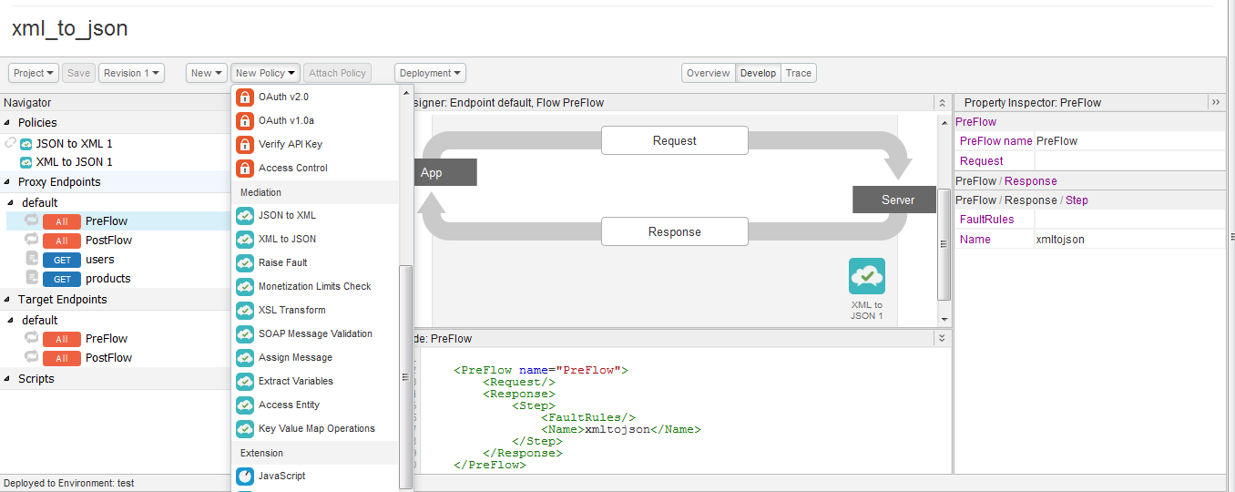
Overall Development view

Slide 38
Convert XML to JSON
To convert messages from the extensible markup language (XML) format to JavaScript object notation (JSON) format. Useful for enabling backend XML services to support RESTful apps that require JSON.
Implementation of Policy:
<?xml version="1.0" encoding="UTF-8" standalone="yes"?>
<XMLToJSONasync="false" continueOnError="false" enabled="true" name="xmltojson">
<DisplayName>XML to JSON 1</DisplayName>
<FaultRules/>
<Properties/>
<Format>yahoo</Format>
<OutputVariable>response</OutputVariable>
<Source>response</Source>
</XMLToJSON>

Slide 39
Convert XML to JSON
Code applied in Proxy Endpoint Default
<PreFlow name="PreFlow"> <Request/>
<Response> <Step> <Name>xmltojson</Name></Step></Response>
</PreFlow>
Output before applying policy :
<?xml version="1.0" encoding="UTF-8" standalone="yes"?>
<users>
<user>
<address>260 Sheridan Avenue, Suite 320 Palo Alto, CA 94306</address>
<id>48</id>
<name>Roger M</name>
<phone>+1 (408) 343-7300</phone>
<shipping> The Summit, 2nd floor B-Wing,Bangalore, India</shipping>
</user>
………

Slide 40
Convert XML to JSON
Output after applying policy :
{"users":{"user":[
{"address":"260 Sheridan Avenue, Suite 320 Palo Alto, CA 94306","id":48,"name":"Roger M","phone":"+1 (408) 343-7300","shipping":" The Summit, 2nd floor B-Wing,Bangalore, India"},
{"address":"260 Sheridan Avenue, Suite 320 Palo Alto, CA 94306","id":509,"name":"John S","phone":"+1 (408) 343-7300","shipping":"One Kingdom Street. Fourth Floor Paddington Central London W2 6BD"}
………
Http Link:
http://my_apigee-test.apigee.net/v1/xml_to_json/users

Slide 41
Convert JSON to XML
To convert messages from the JavaScript object notation (JSON) format to the extensible markup language (XML) format.
Implementation of Policy:
<?xml version="1.0" encoding="UTF-8" standalone="yes"?> <JSONToXMLasync="false" continueOnError="false" enabled="true" name="jsontoxml"> <DisplayName>JSON to XML 1</DisplayName><FaultRules/> <Properties/><Options><NullValue>NULL</NullValue> <NamespaceBlockName>#namespaces</NamespaceBlockName> <DefaultNamespaceNodeName>$default</DefaultNamespaceNodeName> <NamespaceSeparator>:</NamespaceSeparator> <TextNodeName>#text</TextNodeName> <AttributeBlockName>#attrs</AttributeBlockName> <AttributePrefix>@</AttributePrefix> <InvalidCharsReplacement>_</InvalidCharsReplacement> <ObjectRootElementName>Root</ObjectRootElementName> <ArrayRootElementName>Array</ArrayRootElementName> <ArrayItemElementName>Item</ArrayItemElementName> </Options> <OutputVariable>response</OutputVariable> <Source>response</Source></JSONToXML>

Slide 42
Convert JSON to XML
Code applied in Proxy Endpoint Default
<PreFlow name="PreFlow">
<Request/>
<Response>
<Step><Name>jsontoxml</Name></Step>
</Response>
</PreFlow>
Output before applying policy :
{"users":{"user":[
{"address":"260 Sheridan Avenue, Suite 320 Palo Alto, CA 94306","id":48,"name":"Roger M","phone":"+1 (408) 343-7300","shipping":" The Summit, 2nd floor B-Wing,Bangalore, India"},
{"address":"260 Sheridan Avenue, Suite 320 Palo Alto, CA 94306","id":509,"name":"John S","phone":"+1 (408) 343-7300","shipping":"One Kingdom Street. Fourth Floor Paddington Central LondonW 2 6BD"} ………

Slide 43
Convert JSON to XML
Output after applying policy :
<?xml version="1.0" encoding="UTF-8" standalone="yes"?>
<users> <user>
<address>260 Sheridan Avenue, Suite 320 Palo Alto, CA 94306</address>
<id>48</id>
<name>Roger M</name>
<phone>+1 (408) 343-7300</phone>
<shipping> The Summit, 2nd floor B-Wing,Bangalore, India </shipping>
</user> …………
Http Link:
http://my_apigee-test.apigee.net/v1/xml_to_json/users

Slide 44
Apply XSL transformations
XML style sheet language transformations (XSLT) is a language for converting documents from one XML format to another XML format. It is often used to integrate applications that support XML.
The XSL policy requires two inputs.
The name of an XSLT stylesheet, which contains a set of transformation rules) stored in the API proxy under /resources/xsl.
The source of the XML to be transformed.

Slide 45
Apply XSL transformations
Implementation of Policy:
<?xml version="1.0" encoding="UTF-8" standalone="yes"?>
<XSL async="false" continueOnError="false" enabled="true" name="XSLTransform">
<DisplayName>XSL Transform 1</DisplayName>
<FaultRules/>
<Properties/>
<!--<Source>request</Source>-->
<ResourceURL>xsl://XSLTransform-1</ResourceURL>
<Parameters ignoreUnresolvedVariables="true" />
<!--<OutputVariable></OutputVariable>-->
</XSL>
Code applied in Proxy Endpoint Default
<PreFlow name="PreFlow">
<Request/>
<Response>
<Step> <Name> XSLTransform
</Name></Step>
</Response>
</PreFlow>
Http Link:
http://my_apigee-test.apigee.net/v1/xsl_transform/products

Slide 46
Apply XSL transformations
Target Endpoints default
<?xml version="1.0" encoding="ISO-8859-1"?>
<xsl:stylesheet version="1.0"xmlns:xsl="http://www.w3.org/1999/XSL/Transform">
<xsl:output method="text"/> <xsl:variable name="newline“><xsl:text></xsl:text></xsl:variable>
<xsl:template match="/“>
<xsl:text>&lt;XSL_Transformation&gt;</xsl:text><xsl:value-of select="$newline"/>
<xsl:text>XSL Transformation List:</xsl:text> <xsl:value-of select="$newline"/>
<xsl:for-each select="products/product"> <xsl:if test="(position() mod 2) = 1">
<xsl:number format="1. "/> <xsl:value-of select="."/> <xsl:value-of select="$newline"/>
</xsl:if></xsl:for-each>
<xsl:text>&lt;/XSL_Transformation&gt;</xsl:text>
</xsl:template> </xsl:stylesheet>

Slide 47
Apply XSL transformations
Output before applying policy :
<products><product>
<category>Bumper Stickers</category>
<description>I Love Star Trek</description>
<id>2664787</id>
<link>http://176.34.191.52:8080/ProductService/images/layout07_16.jpg</link>
<name>I Love Star Trek</name>
<price>3.99</price>
</product> …………
Output after applying policy :
<XSL_Transformation>
XSL Transformation List:
1. Bumper Stickers I Love Star Trek 2664787 http://176.34.191.52:8080/ProductService/images/layout07_16.jpg I Love Star Trek 3.99 3. Fabric Stickers Cool Star Trek 2263648 http://176.34.191.52:8080/ProductService/images/layout07_18.jpg Cool Star Trek 2.49 5. Fabric Stickers Time Travel 8421949 http://176.34.191.52:8080/ProductService/images/layout07_20.jpg Time Travel 1.49
</XSL_Transformation>

Slide 48
Persist data using KeyValueMap
The KeyValueMapOperations policy provides access to the API Platform's key/value store.
KeyValueMapOperations are typically used to persist long-lived information that needs to be reused over multiple request/response transactions.
KeyValue refers to any arbitrary data in the format key=value, for example localhost=127.0.0.1,zip_code=94110, or first_name=felix.
In the first example, localhost is a key, and 127.0.0.1 is a value.

Slide 49
Persist data using KeyValueMap
Implementation of Policy:
<?xml version="1.0" encoding="UTF-8" standalone="yes"?>
<KeyValueMapOperationsasync="false" continueOnError="false" enabled="true" name="KeyValueMapOperations">
<DisplayName>Key Value Map Operations 1</DisplayName> <Scope>organization/environment/apiproxy/policy</Scope>
<ExpiryTimeInSecs>60</ExpiryTimeInSecs> <FaultRules/><Properties/> <ExclusiveCache>false</ExclusiveCache>
<InitialEntries><Entry> <Key><Parameter>k1</Parameter></Key> <Value>v1</Value> </Entry>..</InitialEntries>
<Put override="true"> <Key><Parameter ref="urlencoding.requesturl.hashed"/></Key>
<Value ref="urlencoding.longurl.encoded"/> <Value ref="request.queryparam.url"/> </Put>
<Get assignTo="urlencoding.shorturl" index='1'>
<Key> <Parameter ref="urlencoding.requesturl.hashed"/></Key></Get>
<Delete><Key><Parameter ref="myvar"></Parameter></Key></Delete>
<Scope>apiproxy</Scope>
</KeyValueMapOperations>

Slide 50
Persist data using KeyValueMap
Code applied in Proxy Endpoint Default
<PreFlow name="PreFlow">
<Request/>
<Response> <Step><Name> KeyValueMapOperations </Name></Step> </Response>
</PreFlow>
Variables Got
urlencoding.requesturl.hashed
urlencoding.longurl.encoded
request.queryparam.url urlencoding.requesturl.hashed myvar
Variables Set
keyvaluemapoperations.KeyValueMapOperations.: true
urlencoding.shorturl: null
Http Link:
http://my_apigee-test.apigee.net/v1/keyvaluemap/users

Slide 51
Persist data using KeyValueMap
Output after applying policy :
<?xml version="1.0" encoding="UTF-8" standalone="yes"?>
<users> <user>
<address>260 Sheridan Avenue, Suite 320 Palo Alto, CA 94306</address>
<id>48</id>
<name>Roger M</name>
<phone>+1 (408) 343-7300</phone>
<shipping> The Summit, 2nd floor B-Wing,Bangalore, India</shipping>
</user> …………
Http Link:
http://my_apigee-test.apigee.net/v1/xml_to_json/users

Slide 52
Exception handling with RaiseFault
The API Platform enables to configure custom exception handling using a policy of type RaiseFault. RaiseFault policy generates a custom message in response to an error condition.
We use RaiseFault to define a FaultResponse that is returned to the requesting app when a specific condition arises.
A FaultResponse can consist of HTTP headers, query parameters, and a message payload. When executed, the RaiseFault policy transfers the message Flow execution to the default ErrorFlow, which in turn returns the designated FaultResponse to the requesting client app.

Slide 53
Exception handling with RaiseFault
Implementation of Policy:
<?xml version="1.0" encoding="UTF-8" standalone="yes"?>
<RaiseFaultasync="false" continueOnError="false" enabled="true" name="RaiseFault">
<DisplayName>Raise Fault 1</DisplayName> <FaultRules/> <Properties/> <FaultResponse>
<!--<Set> <Headers/>
<Payload contentType="text/plain"> <root>Please contact support@company.com</root> </Payload>
<StatusCode>500</StatusCode> <ReasonPhrase>Server Error</ReasonPhrase>
</Set>--> <Set>
<Payload contentType="text/plain"/> <StatusCode>404</StatusCode>
<ReasonPhrase>The resource requested was not found</ReasonPhrase>
</Set>
</FaultResponse>
<IgnoreUnresolvedVariables>true</IgnoreUnresolvedVariables>
</RaiseFault>

Slide 54
Exception handling with RaiseFault
Code applied in Proxy Endpoint Default
<PreFlow name="PreFlow">
<Request/>
<Response> <Step><Name> RaiseFault </Name></Step> </Response>
</PreFlow>
On Trace Response Output
Final response sent to client
404The resource requested was not found.
Variables Got
raisefault.RaiseFault
Variables Set
raisefault.failed: true
Http Link:
http://my_apigee-test.apigee.net/v1/raisefault/users

Slide 55
OVERVIEW OF RESPONSE CACHE POLICY

Slide 56
RESPONSE CACHE POLICY
One of the traffic management policies.
Can be configured to save and periodically refresh copies of response messages.

Slide 57
RESPONSE CACHE POLICY BENIFITS
Reduced Latency
The request is satisfied from the cache so the response is returned in a shorter time, making the API more responsive.
Reduced Network Traffic
Representations are reused, so the impact of processing duplicate or redundant requests is reduced. Response Cache reduces the amount of bandwidth consumed overall.

Slide 58
RESPONSE CACHE POLICY (Cont...)
Response Cache policy is attached to both request and response paths within a Flow
Cached response messages are returned to requesting apps based on request message keys configured in the policy.
At runtime, the API Platform inspects request messages for a 'key' that you specify.
When a key match occurs, the API Platform returns the cached response, instead of forwarding the request to the backend service.

Slide 59
Attaching Response Cache Policy
The Response Cache policy type is unique in that it must be attached to both the request and response Flow in an API proxy.
Response Cache policies are usually attached to the Proxy Endpoint Pre Flow Request and Response.

Slide 60
RESPONSE CACHE POLICY (Cont…)
Ex:
<PreFlow name="PreFlow">
<Request>
<Step>
<Name>ResponseCache</Name>
</Step>
</Request>
<Response>
<Step>
<Name>ResponseCache</Name>
</Step>
</Response>
</PreFlow>

Slide 61
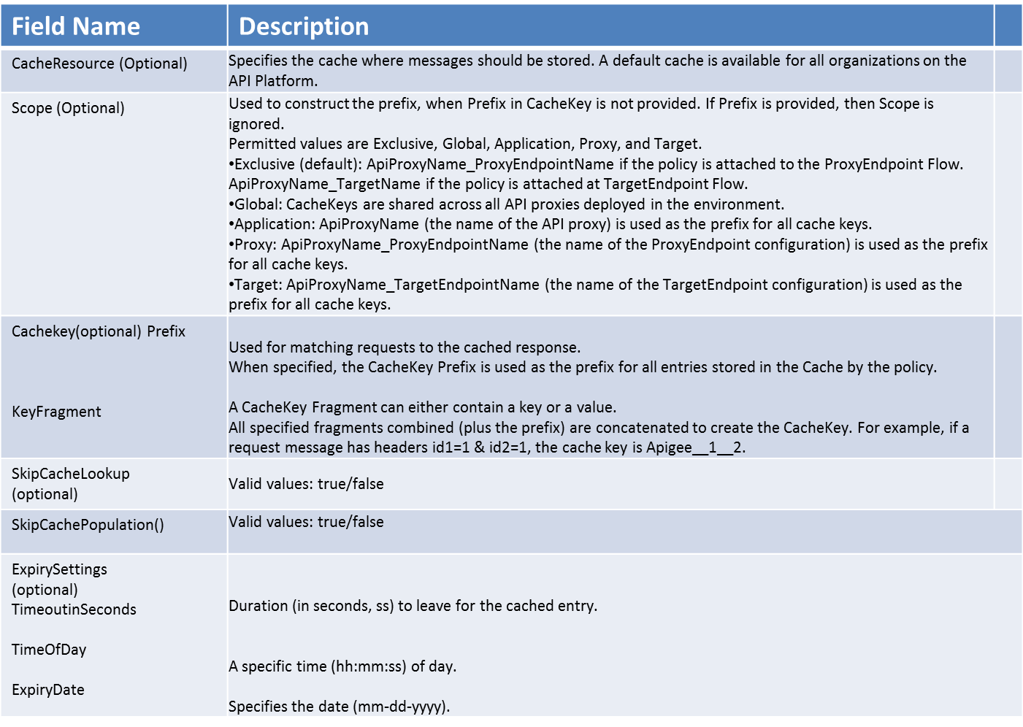
Configuring the Response cache

Slide 62
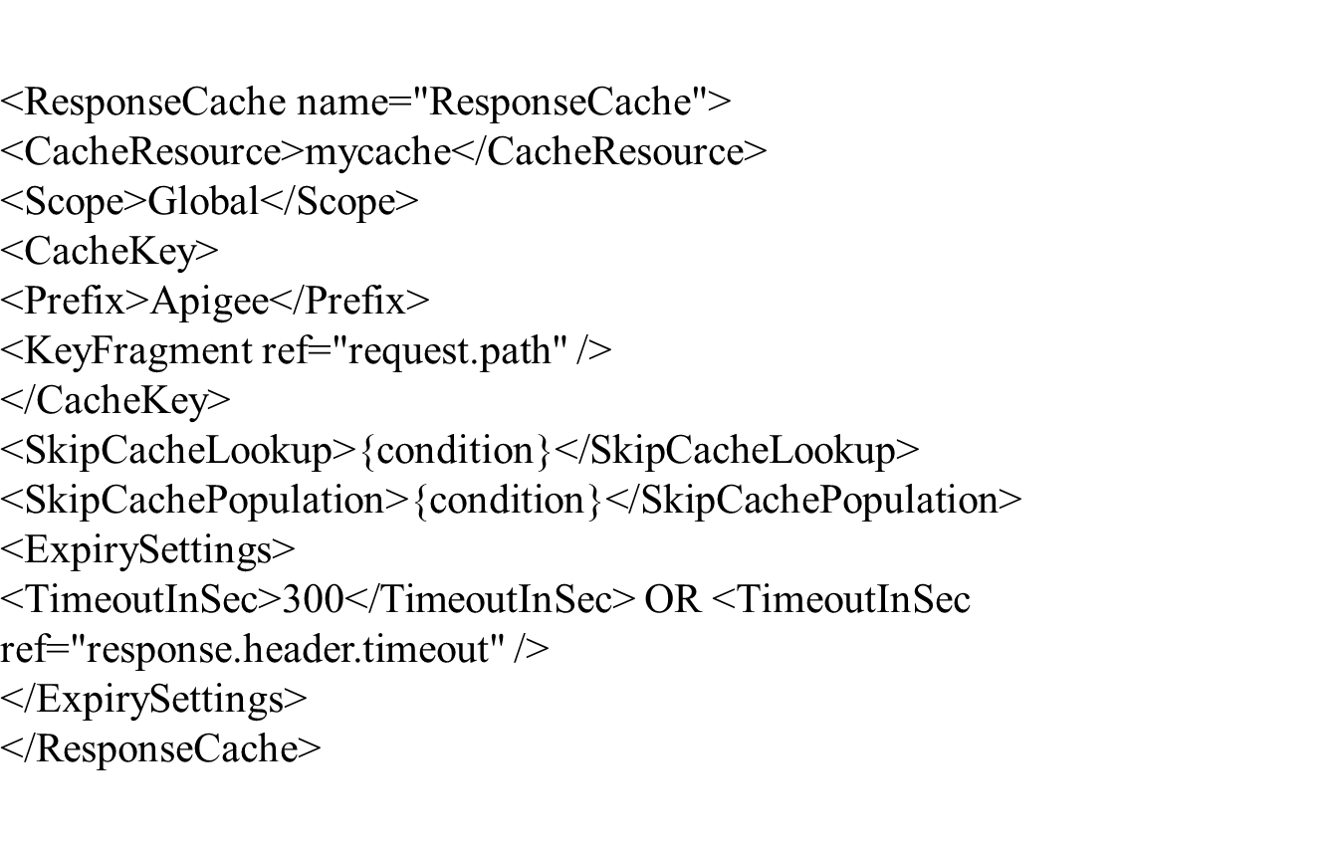
Example Response cache

Slide 63
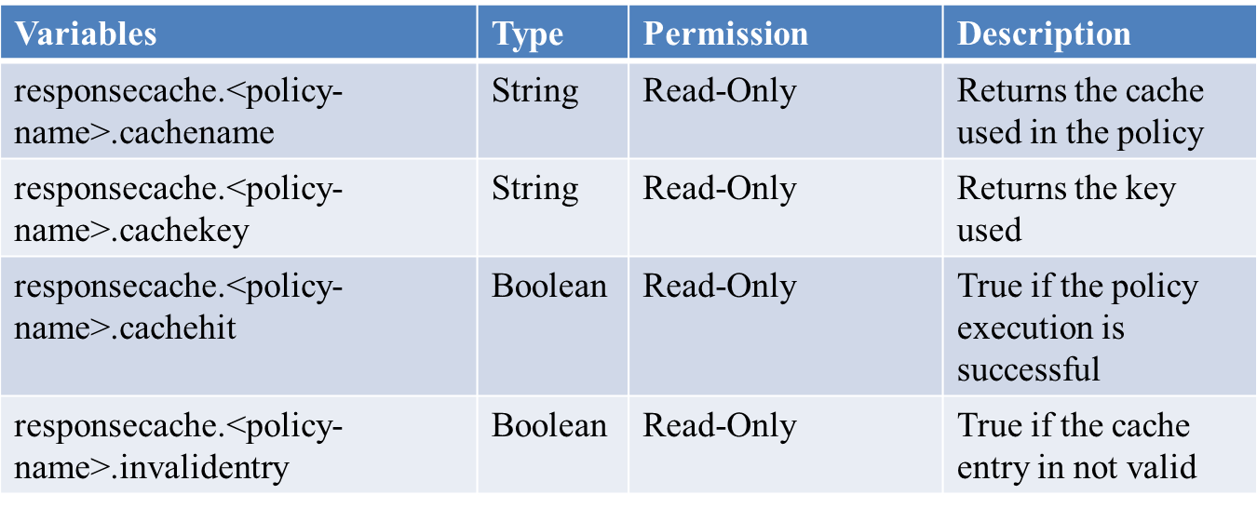
Response Cache Flow Variables

Slide 64
Javascript Policy
It comes under Extension policies list.
Apigee provides a range of out-of-the-box policy capabilities that address common API management requirements.

Slide 65
Javascript Policy ( Cont...)
Apigee exposes scripting interfaces to ease the task of implementing custom behaviors in the proxied API message flow.
A JavaScript policy contains no actual code. Instead, a JavaScript policy references a JavaScript 'resource' and defines the Step in the API flow where the JavaScript executes.

Slide 66
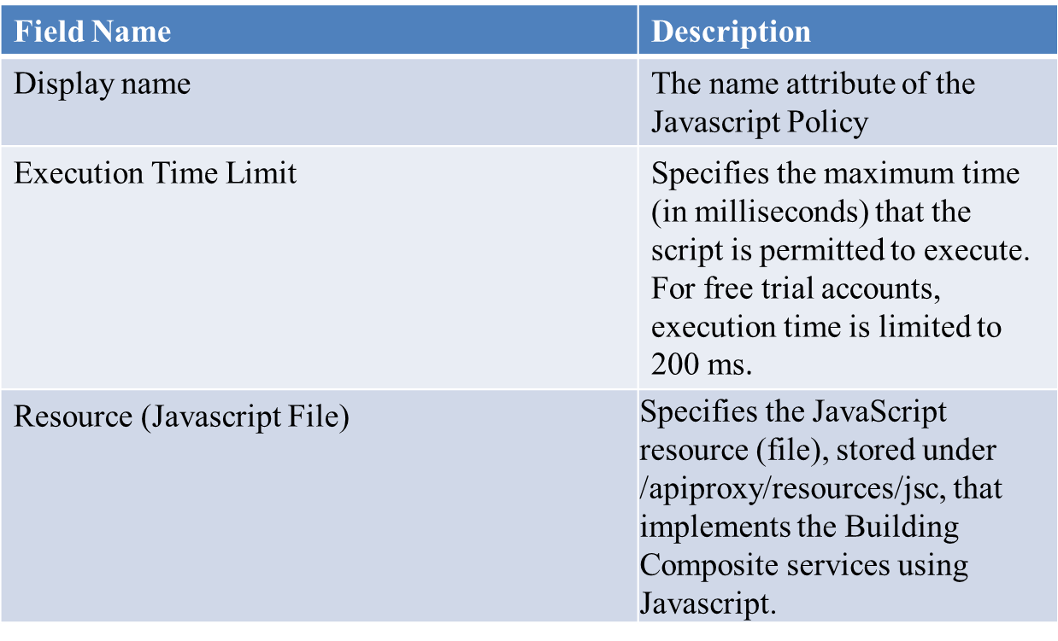
Configuring Javascript Policy

Slide 67
Example Response cache

Slide 68
Response Cache Flow Variables

Slide 69
Javascript Policy
It comes under Extension policies list.
Apigee provides a range of out-of-the-box policy capabilities that address common API management requirements.

Slide 70
Javascript Policy ( Cont...)
Apigee exposes scripting interfaces to ease the task of implementing custom behaviors in the proxied API message flow.
A JavaScript policy contains no actual code. Instead, a JavaScript policy references a JavaScript 'resource' and defines the Step in the API flow where the JavaScript executes.

Slide 71
Configuring Javascript Policy

Slide 72
Example - Javascript Policy
<?xml version="1.0" encoding="UTF-8" standalone="yes"?>
<Javascript timeLimit="200" enabled="true" continueOnError="false" async="false" name="MyJSPolicy">
<ResourceURL>jsc://MyJavaScript</ResourceURL>
<IncludeURL>jsc://MyJavaScript</IncludeURL>
</Javascript>

Slide 73
Spike Arrest

Slide 74
Why Spike Arrest
APIs consumed by heterogenous client apps are vulnerable to performance lags and downtime caused by the sudden influx of request messages.
SpikeArrests stop traffic spikes (or bursts) that can be caused by an increase in usage, buggy clients, or malicious attacks.

Slide 75
How it Works
SpikeArrest throttle the number of requests forwarded from the point in the processing Flow where the Policy is attached a s processing Step. You can attach a SpikeArrest policy at the ProxyEndpoint request Flow to limit inbound requests. You can also attach the SpikeArrest policy at the TargetEndpoint request Flow to limit request forwarded to the backend service.
SpikeArrest policies support throttling over short time intervals, such as seconds and minutes. A SpikeArrest configuration allows messages to pass at a steady rate, while any instantaneous bursts are suppressed

Slide 76
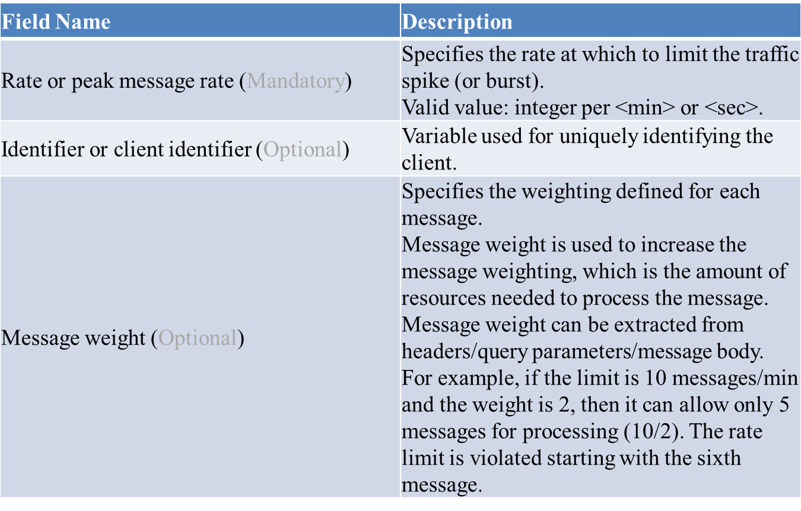
Spike arrest Configuration elements

Slide 77
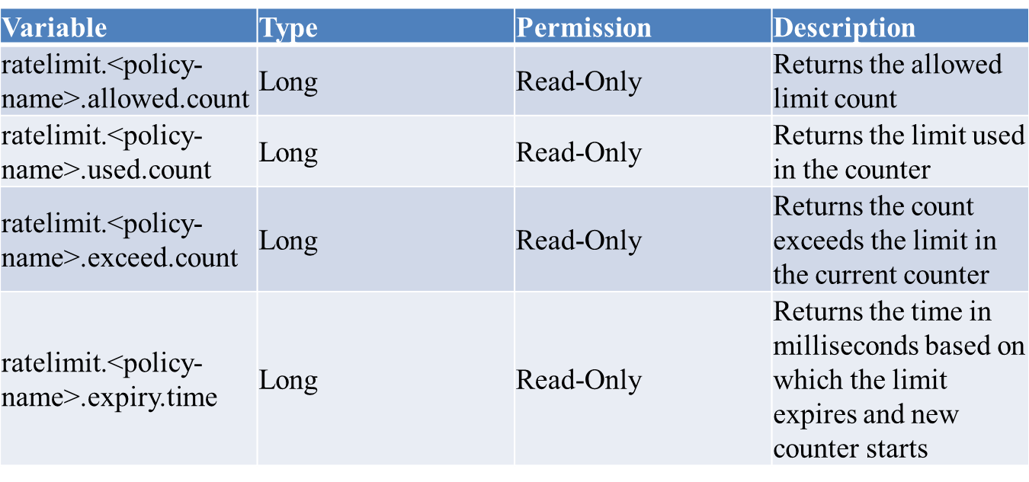
When spike arrest policy runs following variables are populated

Slide 78
Invalidate Cache

Slide 79
What is cache
Cache resource that can be used at runtime to persist data across transactions.

Slide 80
Cache in Apigee
We can have multiple Cache resources in each environment. For data segregation, the scope of a Cache is limited to an environment in which the Cache is created. (For example, API proxies running in a 'test' environment cannot access data in a Cache running in 'prod'.) Once the Cache is created, it can be populated with any serializable data by using Cache policies.
A default Cache resource called mycache is configured in each environment for every organization. Under ordinary circumstances, you do not need to explicitly configure a Cache. Only configure a Cache when you need to customize the Cache settings and configuration optimize performance.

Slide 81
Invalidate Cache
The Cache resource can be invalidated explicitly by specifying an HTTP header. When a request that contains the specified HTTP header is received, the Cache is flushed.
<InvalidateCache name="InvalidateMyCache">
<CacheResource>test-cache</CacheResource>
<Scope>Exclusive</Scope>
<CacheKey>
<Prefix>apiAccessToken</Prefix>
<KeyFragment ref="request.header.invalidate_cache" />
</CacheKey>
<PurgeChildEntries>true</PurgeChildEntries>
</InvalidateCache>

Slide 82
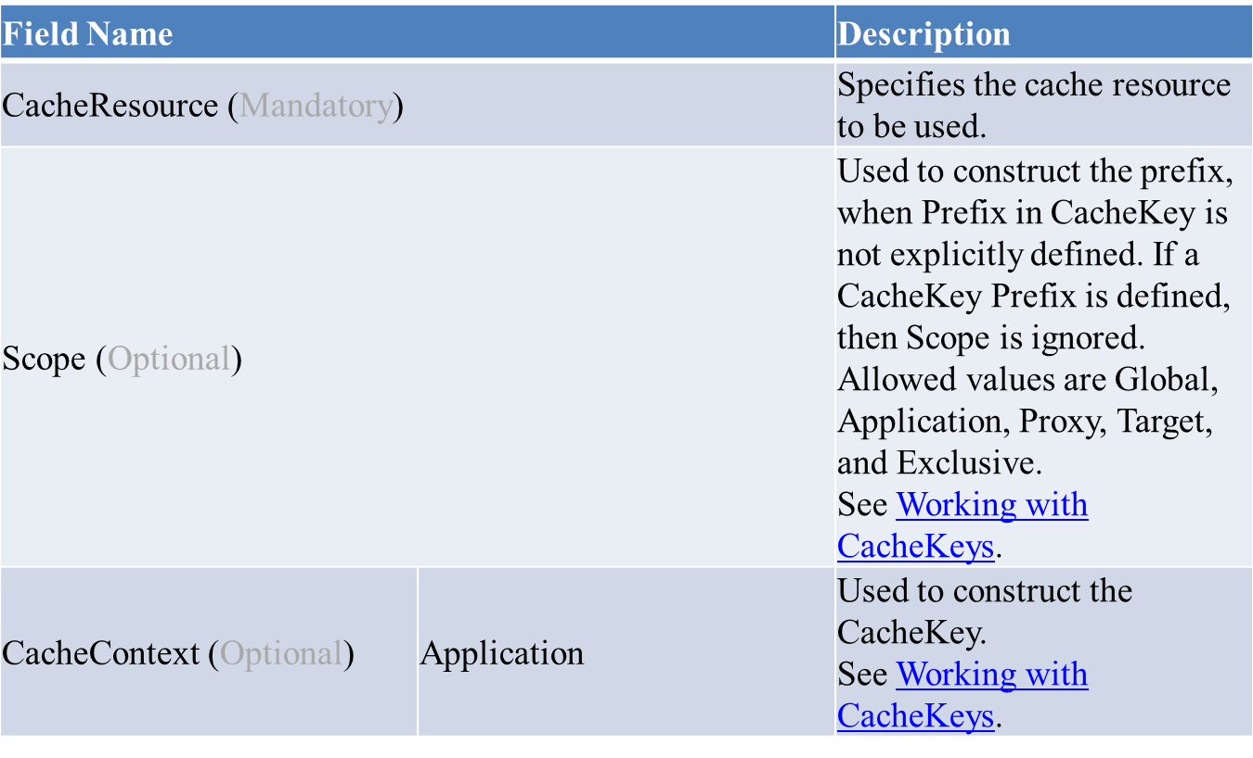
Properties

Slide 83
API ANALYTICS

Slide 84
Introduction
Analytics enables you to view long-term usage trends, segment consumers by top developers and apps, and manage your APIs as a business.
Apigee collects statistics, or metrics, on API traffic as it flows from apps to APIs.
The statistics Apigee collects API call information (such as URL, IP address, and userid), total response time, backend response time, maximum response time, error rate, No of Cache hits and data exchanged.
You can augment the metrics collected by Apigee with custom app- or business-specific data by defining policies that extract, collate, and compute analytics on the custom data that you define. Custom metrics can be collected from message headers, query parameters, as well as the content of XML or JSON request or response messages.
The statistics collected are used to generate reports, which can be tailored to your needs by collecting metrics specific to your APIs and the apps that use them.

Slide 85
Monitor the performance of your API
Data and metrics are key to managing the performance of your API program, because you can't manage what you can't measure. Information about the different data is very important to the API team, developers, the API operations team, and others for the accomplishment of making the API programs.
API traffic monitoring metrics are useful for managing the business side of your APIs. These metrics are available from the Dashboard page and provide a high-level view of all the APIs in your organization. They give you insight into which APIs are most popular with customers and how much traffic is flowing through all your APIs. Top API movers, Top Developer Apps and Top Products and Top Developers are the views to know the trends of different APIs .
API performance metrics are useful for managing the operations side of an organization. These metrics are available on the Dashboard tab and provide insight into traffic, response time, and errors per API.

Slide 86
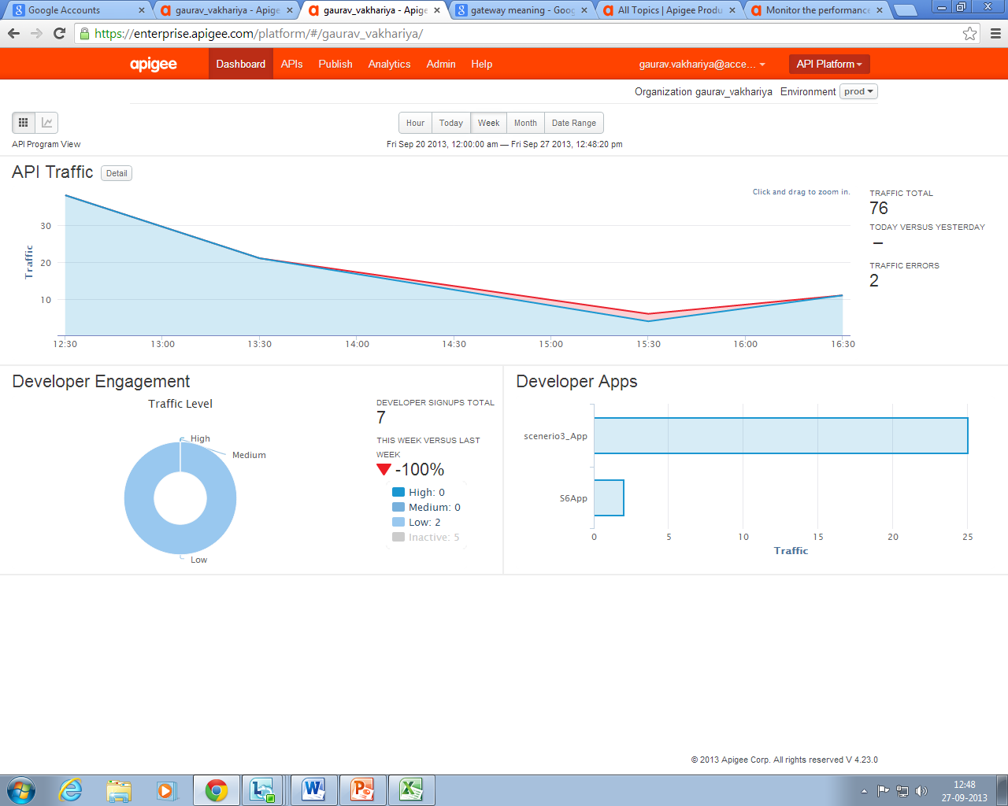
ENTERPRISE DASHBOARD

Slide 87
REPORTS
As data passes through Apigee, it collects information about the traffic and stores it as measures and dimensions. By combining different measures, dimensions, and filters, you can generate reports that show you the exact data that you want to see.
Measures are numeric representations of a set of activities that have occurred. For example:
The message_count measure shows you the message count for the APIs e.g. Traffic.
The is_error measure pinpoints the APIs that are causing issues with your server e.g. Proxy Errors,Policy Errors and Target Errors.
The total_response_time measure helps you see how your server is performing e.g.Target Response time,Total Response time and Response processing Latency.

Slide 88
REPORTS(Cont...)
Dimensions(DrillDown) are categories of information used to group data. You can view measures by dimension. For example No fo Api calls(Traffic) by productid(custom attribute). Dimensions can be stacked to create drilldowns, meaning that you can select a top-level dimension and then each successive dimension further refines the data to focus in on a smaller and smaller subset of data. Examples of measures include proxy, organization,
client_id, and developer.
Filters let you further refine reports by including or excluding data based on expressions.

Slide 89
MEASURES
target_response_time:- The time taken to receive a response from the customer end point to the Apigee proxy for a request.
cache_hit:- An API request that is serviced from the Apigee cache successfully (the request is not forwarded to the customer end point).
request_size:- The size of an API request as seen by the Apigee proxy measured in kilobytes.
response_processing_latency:- The time it takes to process an API request at the Apigee proxy measured in milliseconds.
total_response_time:- The total time taken for an App to receive a response for an API request. This is the sum of the request processing latency of the Apigee proxy, request processing latency of the customer end point, response generation latency of the customer end point and the response processing latency of the Apigee proxy. It also includes the latency introduced by the network layer as the request can go through multiple networks (also the response) before it reaches its destination
is_error:- A request is marked as "is_Error" when the request can not be serviced successfully.
Traffic:- The total number of API requests (and responses) that are seen by the Apigee proxy.

Slide 90
Statistics Collector Policy for Custom Reports
The StatisticsCollector policy (also referred to as Custom Analytics) allows you to collect statistical data for messages processed in a flow, such as product ID, price, REST action, client and target URL, and message length (predefined flow variables as well as custom variables). The data is then provided to the analytics server, which analyzes the statistics and generates reports. You can view the reports through Apigee Analytics services.
In Apigee, you can attach a Statistics Collector policy to the response path in your APIs, where you can capture and publish a range of statistics to the analytics server.

Slide 91
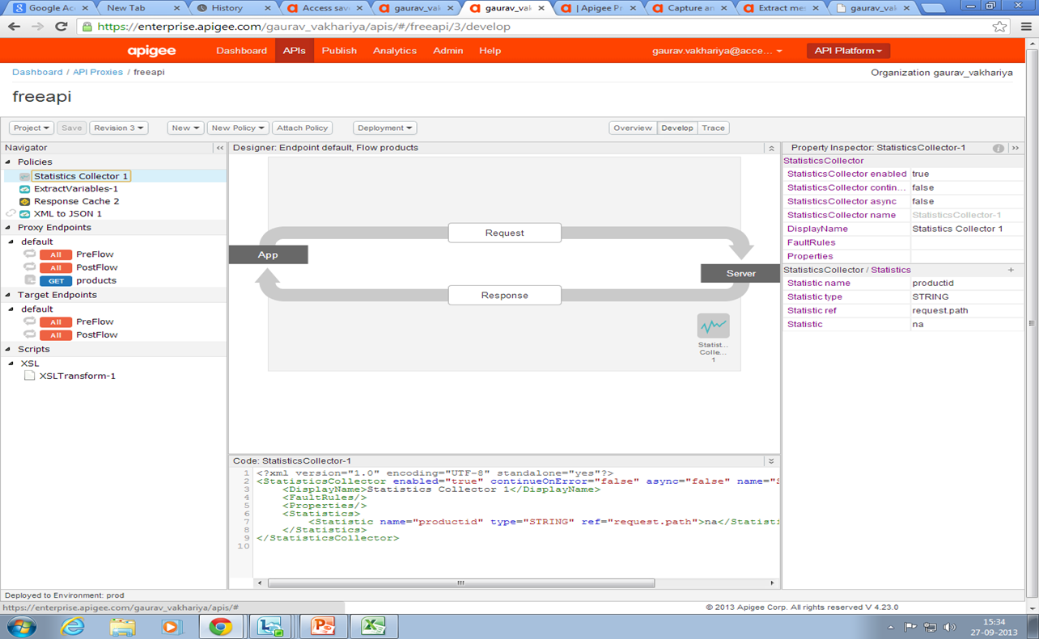
Statistic Collector Policy View

Slide 92
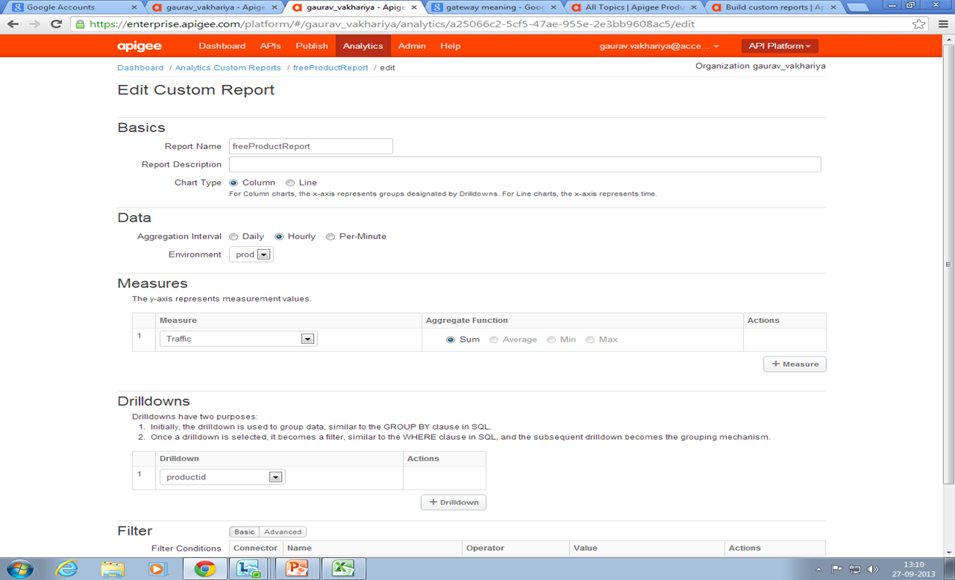
Custom Report View

Slide 93
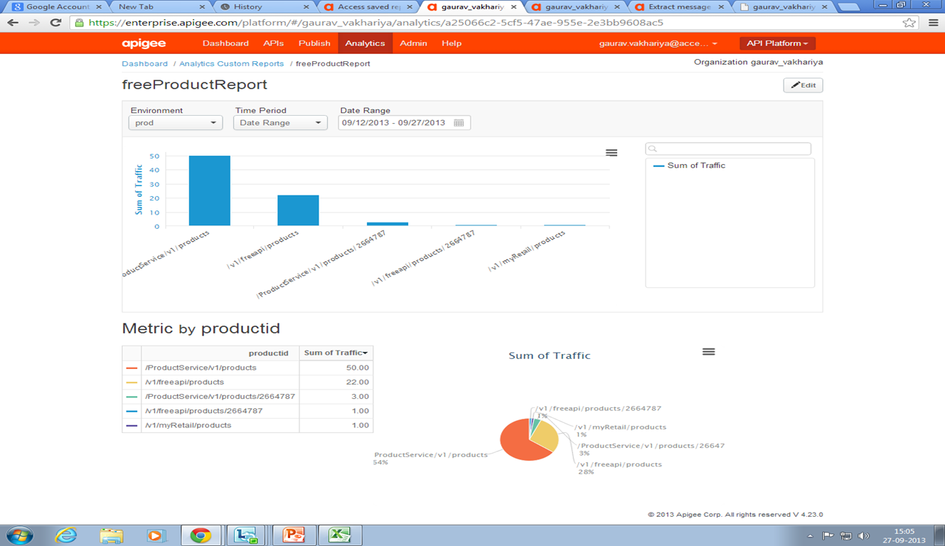
Access saved reports
1)Traffic vs Productid

Slide 94
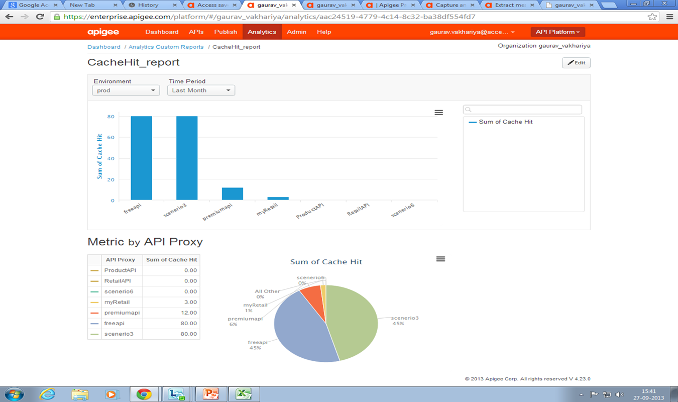
2)No of Cache Hits vs API Proxy

Slide 95
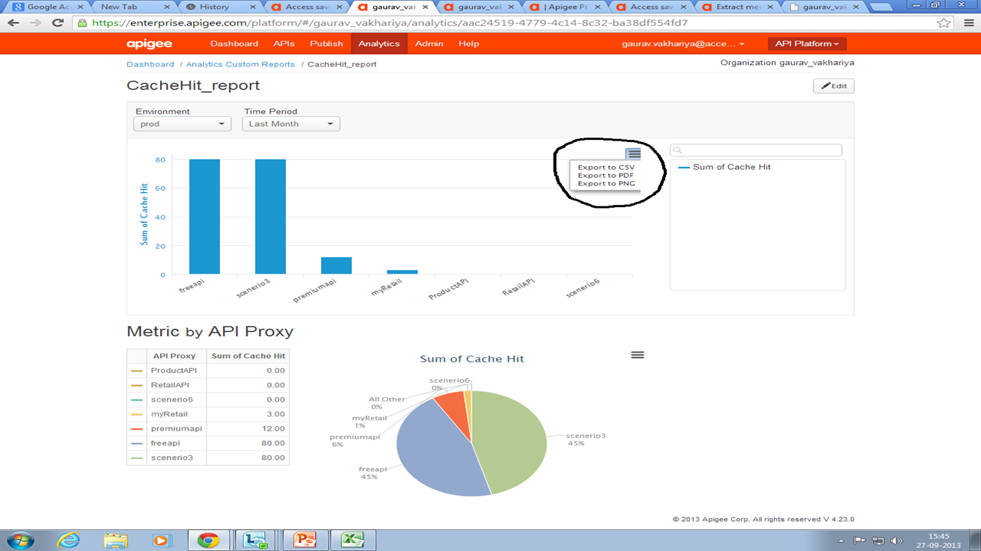
Exporting saved reports
You can export a saved custom report to CSV, PDF or PNG format. Each report includes an export menu where you can select a format for the export.

Slide 96
API Publish

Slide 97
The Publish Link
The Apigee Publish link can be used to :
Create/Modify Products (under “Product” sub menu)
Add/Delete a developer (under “Developers” sub menu)
Create/Modify the apps created by the developers(under “Developer Apps” sub menu)

Slide 98
Products
What is a product?
A product is a bundle of resources.
Resources could be bundled together for the developers to consume.
We can have different products to support different use-cases.

Slide 99
Products (Cont…)
How to create a product?
From the Apigee page, navigate to:
Publish > Products
Click on the add (+) Product button.
On the Add Product page, enter a name and description for the product.
“name” field is mandatory.
“description” is optional but it’s a good practice to provide some details.

Slide 100
Products (Cont…)
Select the test environment for internal-facing products or the production environment for public-facing products.
Enable an access level option. There are 3 options:
Internal Only : Visible only to developers at <organization> during app registration.
Private : Visible only to external developers with explicit permission during app registration.
Public : Visible only to any registered developer during app registration.
Access level can be used during the different stages of development.

Slide 101
Products (Cont…)
Select automatic key approval or manual key approval. Click on the radio button for this.
If you select automatic key approval, all key requests that come in from any app that uses this API product are automatically approved.
If you choose manual key approval, you will have to approve key requests that come in from any app that uses this API product.

Slide 102
Products (Cont…)
Enter a service limit number and select a time period (minute, hour, day, week, month). This sets up a quota for your product that limits the number of calls the product accepts in a given time period.
Enter a scope for the product (such as 'Read'). The scope should match one of the scopes you defined in your security policy. If they don't match your API may not be secure.

Slide 103
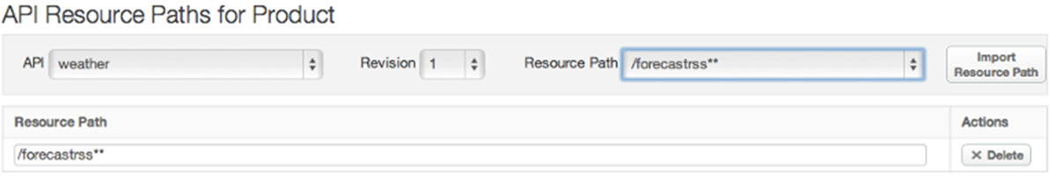
Products (Cont…)
In the API Resource Paths for Product section, select the API, Revision, and Resource Path for the API you want to add.

Slide 104
Products (Cont…)
Click Import Resource Path, then click Save. The new product appears in the table on the Products page.

Slide 105
Products (Cont…)
Controlling access to products.
Adding Access to a product
Select an app in the Developer Apps summary table.
On the Developer App page, click Edit.
In the Products section of the Edit Developer App page, click + Product, select the product you want to add to the app, and click the check mark icon.
Click Save. The product is added to the app.

Slide 106
Products (Cont…)
Revoking access to a product
On the Developer App page, click Edit.
Select an app in the Developer Apps summary table.
In the Products section of the Edit Developer App page, click Revoke next to the product.The Revoke button changes to Approve in case you want to make the app part of that product again.
Click Save.

Slide 107
Products (Cont…)
Deleting a product from an app
Select an app in the Developer Apps summary table.
On the Developer App page, click Edit.
In the Products section of the Edit Developer App page, click Remove next to the product.
Click Save.

Slide 108
Products (Cont…)
Keys
Keys are auto generated when an app is created.
If you specified automatic key approval when you created the API Product, the key is automatically approved for use by the app. Otherwise, you need to approve the key manually before the key can be used by the app to access the product. Each app is assigned a key and secret key.
Keys together act as a username/password combo.

Slide 109
Products (Cont…)
When an application makes a request, Apigee inspects it to verify that the API key matches the resource that the app is requesting, and checks the API product definitions associated with API key to see whether the resource is permitted. If everything lines up, Apigee sends back the requested resource data.

Slide 110
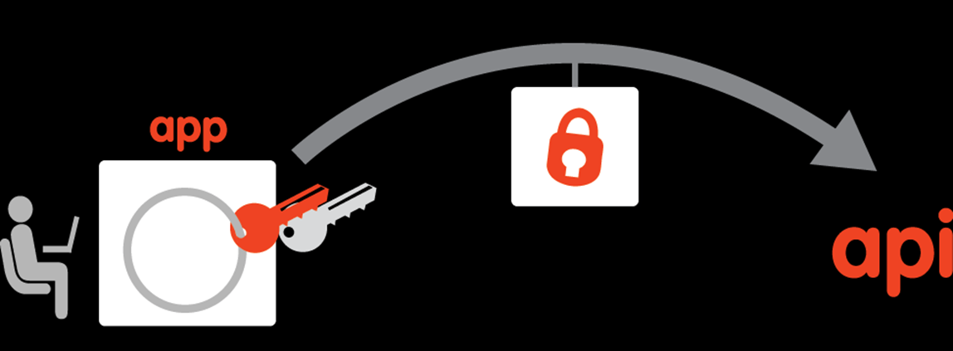
Products (Cont…)

Slide 111
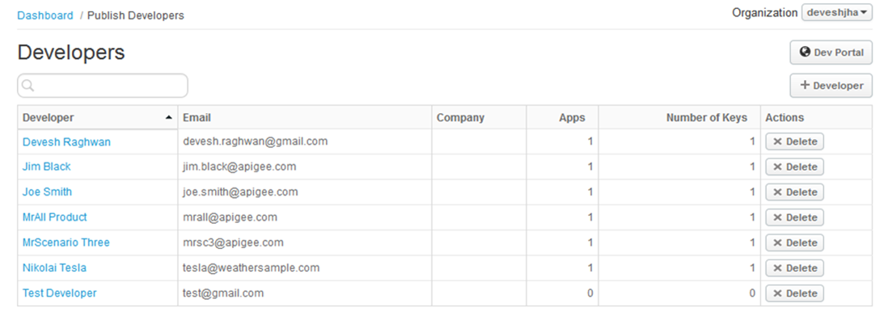
Developers
Who is a developer?
A developer access the API through apps that contain keys, which in turn provide access to the API products.
An app can not be created without a developer.
An organization must have a developer registered.

Slide 112
Developers
Who is a developer?
A developer access the API through apps that contain keys, which in turn provide access to the API products.
An app can not be created without a developer
An organization must have a developer registered.

Slide 113

Developers (Cont...)

Slide 114
Developers (Cont...)
How to create a developer?
Navigate to the following page: Publish > Developers
Click the (+) Developer App button.
Enter the first name for your developer.
Enter the last name for your developer.
Enter the developer's email.
This is the email address that you use to send keys and notifications to this developer.

Slide 115
Developers (Cont...)
Optionally, add custom attributes for the developer. For each custom attribute:
Click (+) Add Custom Attribute.
Enter the attribute name and value.
Click Save. The new developer appears in the table on the Developers page.

Slide 116
Developer Apps
What is a developer app?
Apps are how your developers access the resources in your API products.
When an app is created, we select the API products to include, and Apigee generates a key.
By default, a single key provides access to multiple API products—newly approved API products are added to the existing API key by the system.

Slide 117
Developer Apps (Cont…)
When the application makes a request, Apigee inspects the request to verify that the API key matches the resource that the app is requesting.
It checks any API product definitions associated with API key to see whether the resource is permitted.
If everything is fine, Apigee sends back the requested resource data.

Slide 118
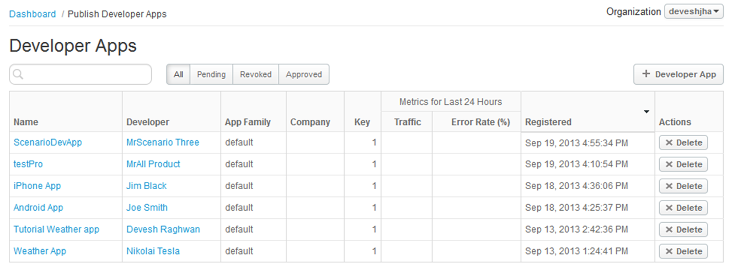
Developer Apps (Cont…)

Slide 119
Developer Apps (Cont…)
How to add a developer app?
Navigate to: Publish > Developer App
Click the (+) Developer App button.
Enter a name for the app.
Enter the URL for the callback.
A callback is the location of a resource that belongs to the applications. In most cases, this is the location of a login screen where app end users enter their username and password.

Slide 120
Developer Apps (Cont…)
Select a developer from the Developer list. Your app must have a developer.
Optionally, add a descriptive note.
Optionally add custom attributes for the app. For each custom attribute:
Click (+) Add Custom Attribute.
Enter the attribute name and value.
Click Save. Your new app appears in the apps table on Developer Apps page.

Slide 121
PUSH NOTIFICATIONS

Slide 122
Why Push Notifications
Push notifications are used to ping app users with messages they care about: a new service they might be interested in, a flash sale happening near them right now
Apigee App Services provides a RESTful framework for sending push notifications to your apps
To receive push notifications, users must be using devices that can connect to App Services.
Compare this with CPU- and memory-heavy pull processes, in which a user actively listens on an endpoint, regularly pulling data (such as news feeds, new emails, or stock market updates) to the device.

Slide 123
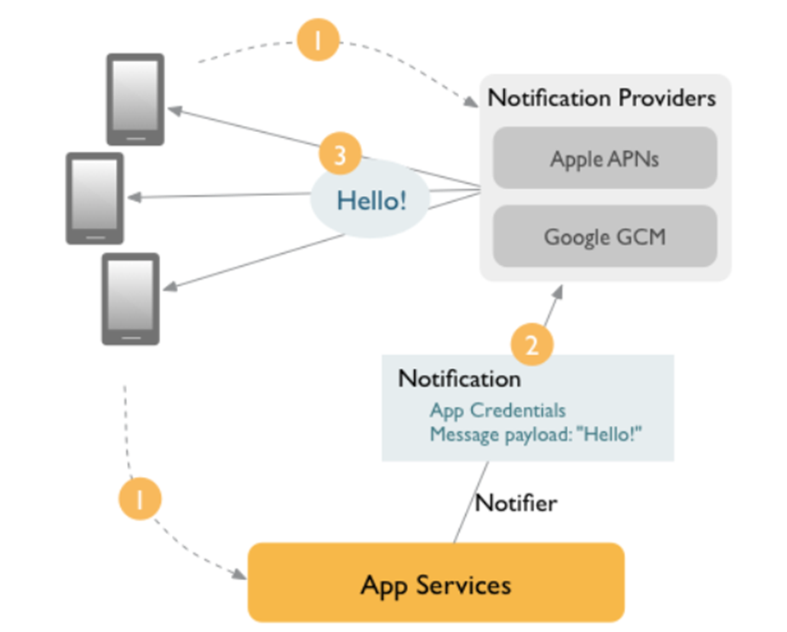
How it Works!!

Slide 124
How it Works!!
Your app registers with App Services and push notification providers receiving credentials for use when sending notifications.
This makes the providers aware of the devices on which your app is installed, allowing you to target those devices with push notifications.
Create App Services notifiers
Send notification requests to notification providers, using your app's credentials to authenticate
Push notification providers forward your notifications to the targeted devices

Slide 125
How to add push notification
Register your app with push notification providers (such as Apple and Google)
Create notifiers. Notifiers contain the credentials your notifications need to access the notification providers.
Register devices with push notification providers and App Services.
Send and manage push notifications using the notification endpoints in App Services to target devices, users, or groups

Slide 126
Creating notifications
When a notification is created in app services, it is scheduled to be delivered to all applicable devices immediately, unless the deliver property has been set. A notification may contain multiple messages
Each payload must be associated with a notifier in order to deliver that message to the associated app. This allows a single notification to be delivered to multiple apps across various providers, and is useful if you want to send messages to multiple notifiers, such as development and production versions of both Apple and Google

Slide 127
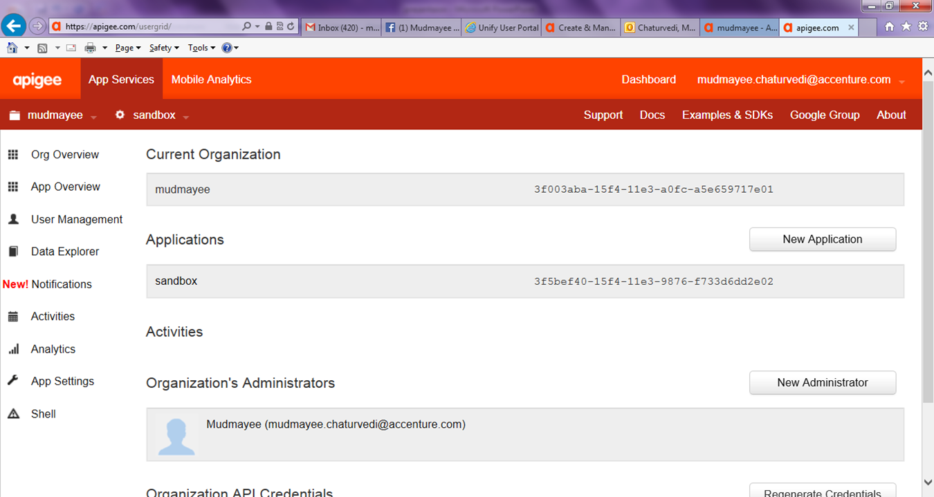
Creating notifications

Slide 128
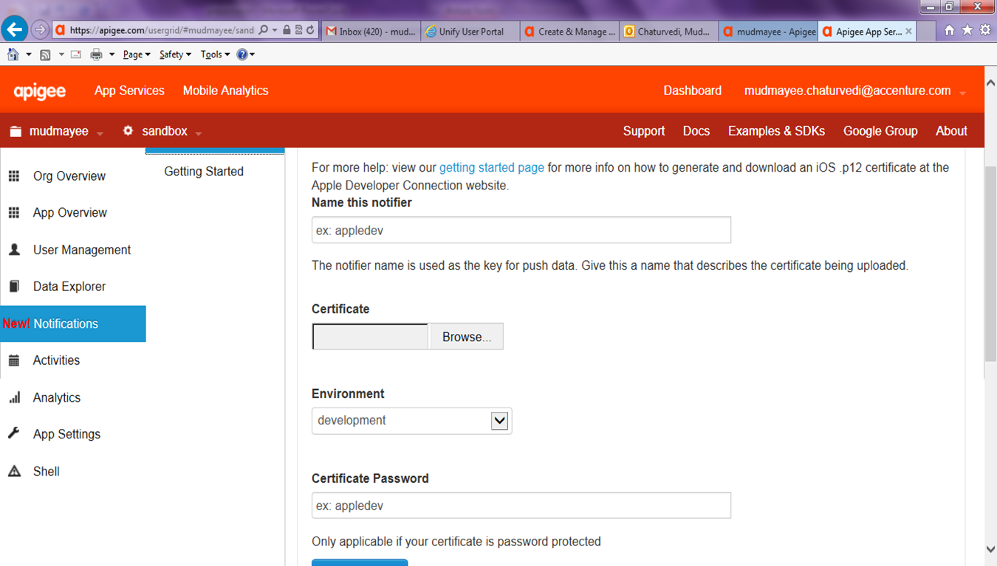
Creating notifier

Slide 129
Getting started..
Enter the message (payload) you want delivered in the Notifier Message field
Click Schedule Notification. Your notification will be delivered immediately.

Slide 130
Scheduling
Beneath 'Delivery', click the Schedule for later radio button.
Select the date and time you want the notification to be sent.

Slide 131
Targeting notifications
From the App Services console, create a new notification.
Beneath the notifier drop-down, click the radio button for the type of entity you wish to target with the push notifications.
Enter the device, user or group name(s) or UUID(s) you wish to target in the field below the radio button.

Slide 132
http://apigee.com/docs/app-services/content/push-notifications-overview
http://apigee.com/docs/app-services/content/create-manage-notifications
http://apigee.com/docs/app-services/content/register-your-app-apple-apns-or-google-gcm

Slide 133
APIGEE API CONSOLE

Slide 134
Means & definition
Console: Represents the standard input, output, and error streams for console applications. Console applications are programs designed to be used via a text-only computer interface
Application Programming Interface (API): It specifies how some software components should interact with each other. In addition to accessing databases or computer hardware, such as hard disk drives or video cards, an API can be used to ease the work of programming graphical user interface components. In practice, many times an API comes in form of a library that includes specifications for routines, data structures, object classes, and variables. In some other cases, notably for SOAP and REST services, an API comes as just a specification of remote calls exposed to the API consumers.

Slide 135
Means & definition
Api Providers - Tied up with Apigee
Console / Apigee API Console
[Contains API, Service(1..n), Authentication (No Auth, Outh, Basic Auth), API Methods(GET, PUT, POST, DELETE)]
Each Request URL - have Query, Template, Header & Body (contains parameter, value & Description)
What's on API Console
Apigee API Consoles make it easier for developers to learn and use an API. You can think of a Console as a "GUI for an API" or "cURL on steroids." Featuring an easy-to-use interface, Apigee API Consoles provide a GUI for exploring an API's resources and executing its methods.

Slide 136
Means & definition
What is Apigee Console To-Go?
Apigee Console To-Go is your own Apigee API Console—on your own site. Just describe your API using the Web Application Description Language (WADL), upload your description to Apigee to create a custom Console, customize the look and feel, and then embed your API Console on your own developer portal.
Steps to setup an Apigee API Console
1. Naming Console
2. Set Credentials
3. Describe API
4. Style Console
5. Embed Console
http://apigee.com/docs/api-platform/content/whats-api-console
http://apigee.com/docs/api-platform/content/set-apigee-api-console
http://apigee.com/docs/consoletogo/content/wadl-reference
https://apigee.com/togo

Slide 137
Means & definition
WADL(Web Application Description Language): It is an xml based file format that provides a machine readable description of HTTP-based Web APIs. WADL file defines
Resources that contstitute an API
Defines one or more methods that act on those resources.
Restful APIs method combination of resource (URI) and HTTP(GET, PUT, POST & DELETE) that acts an resource (CRUD Operation).
Style Console: A web style console is a form of separation of presentation and content for web design in which the markup (i.e., HTML or XHTML) of a webpage contains the page's semantic content and structure, but does not define its visual layout (style). Instead, the style is defined in an external style sheet file using a style sheet language such as CSS or XSLT.

Slide 138
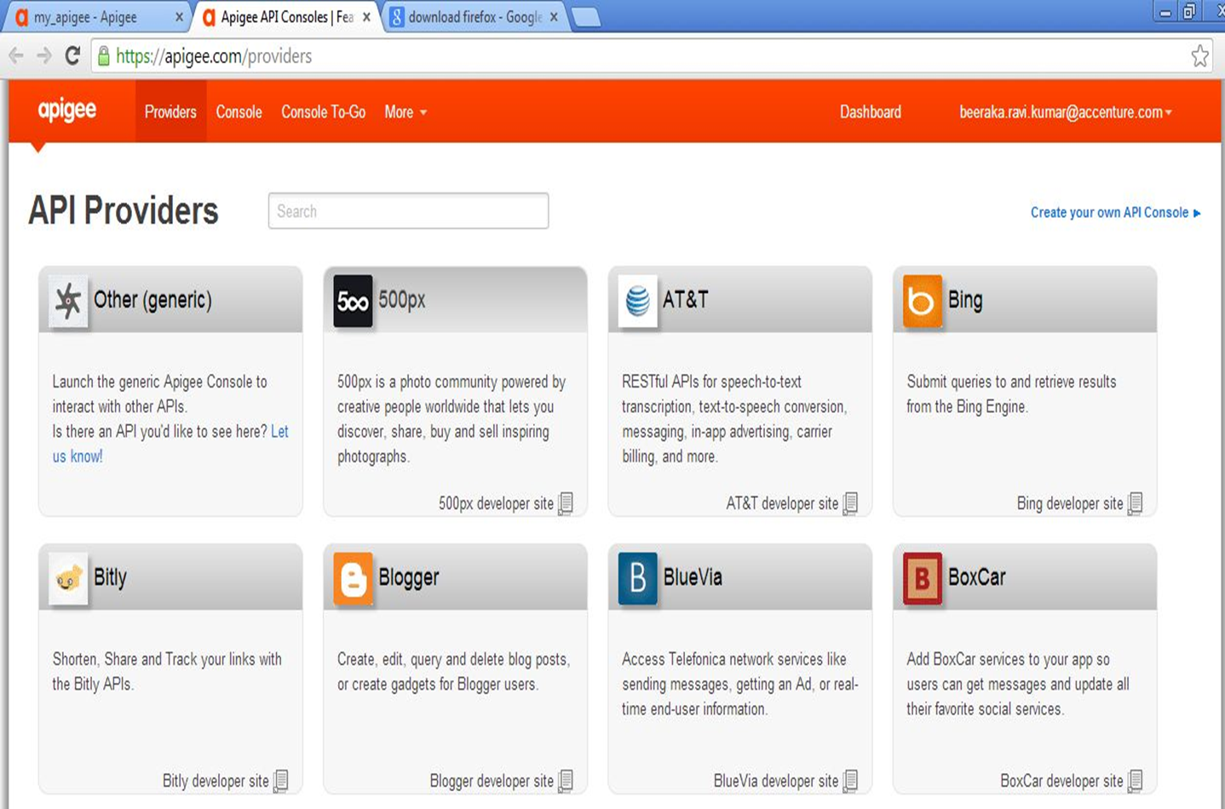
Apigee API Providers

Slide 139
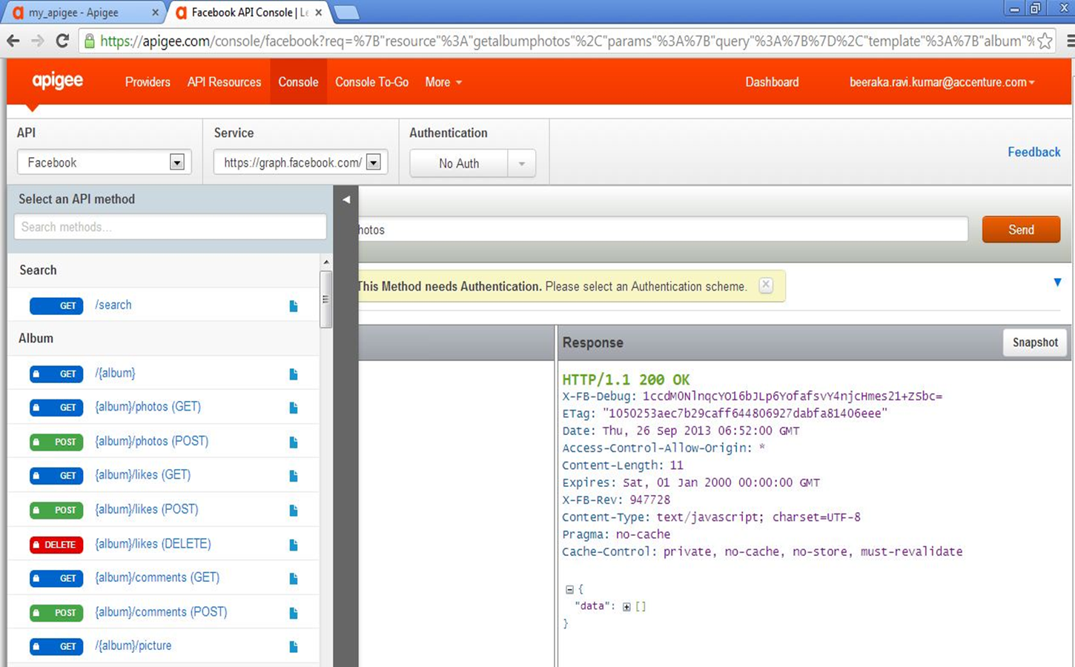
Apigee API Console

Slide 140
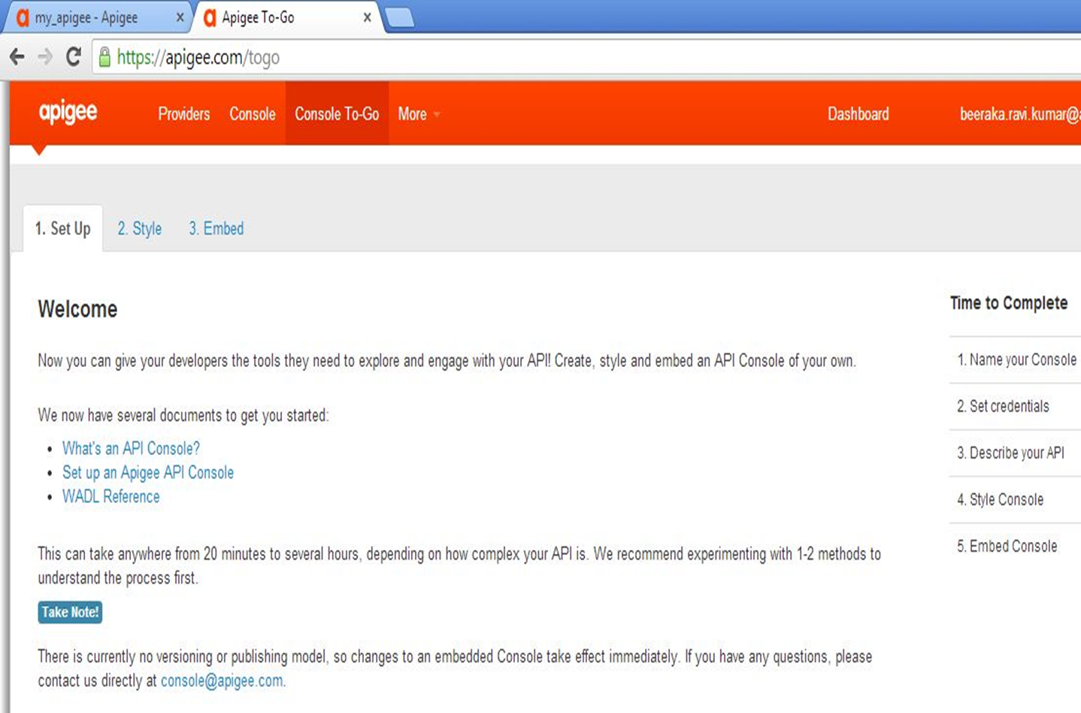
Apigee Console Setup

Slide 141
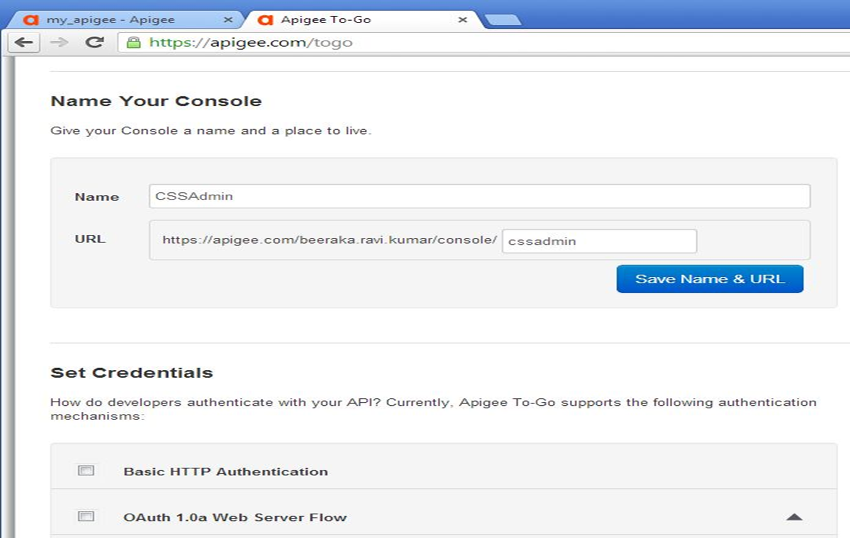
Apigee Console Credentials

Slide 142
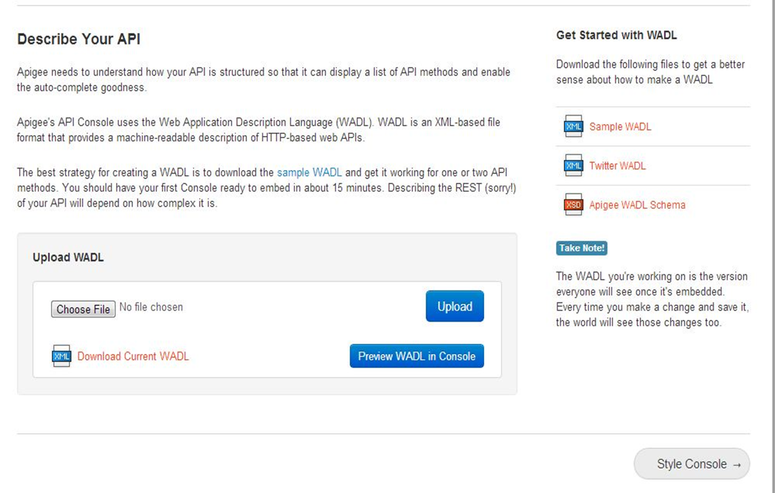
Describe API – Upload WADL

Slide 143
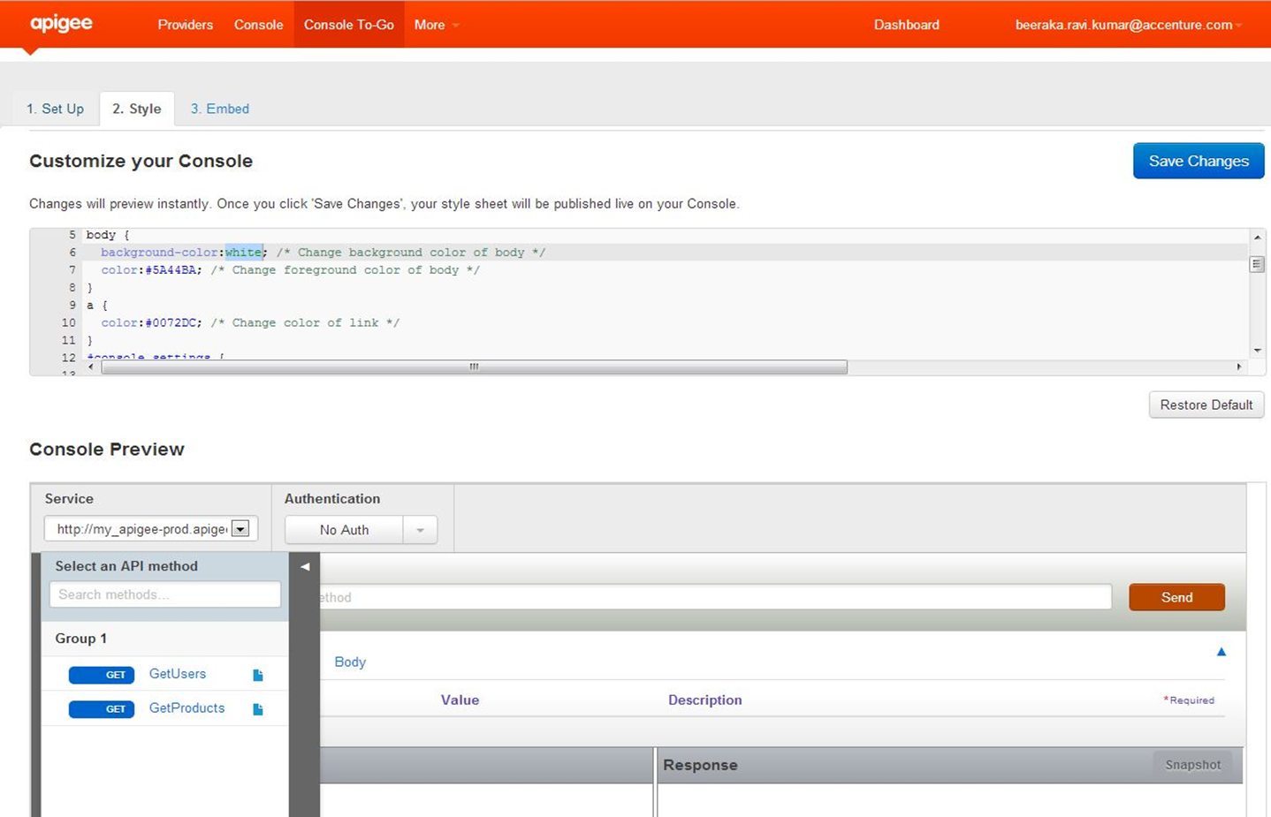
Customize API Console/Preview

Slide 144
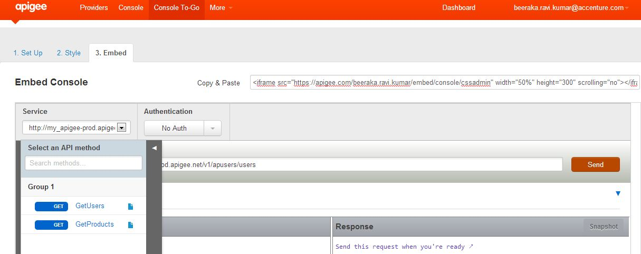
Embed API Console

Slide 145
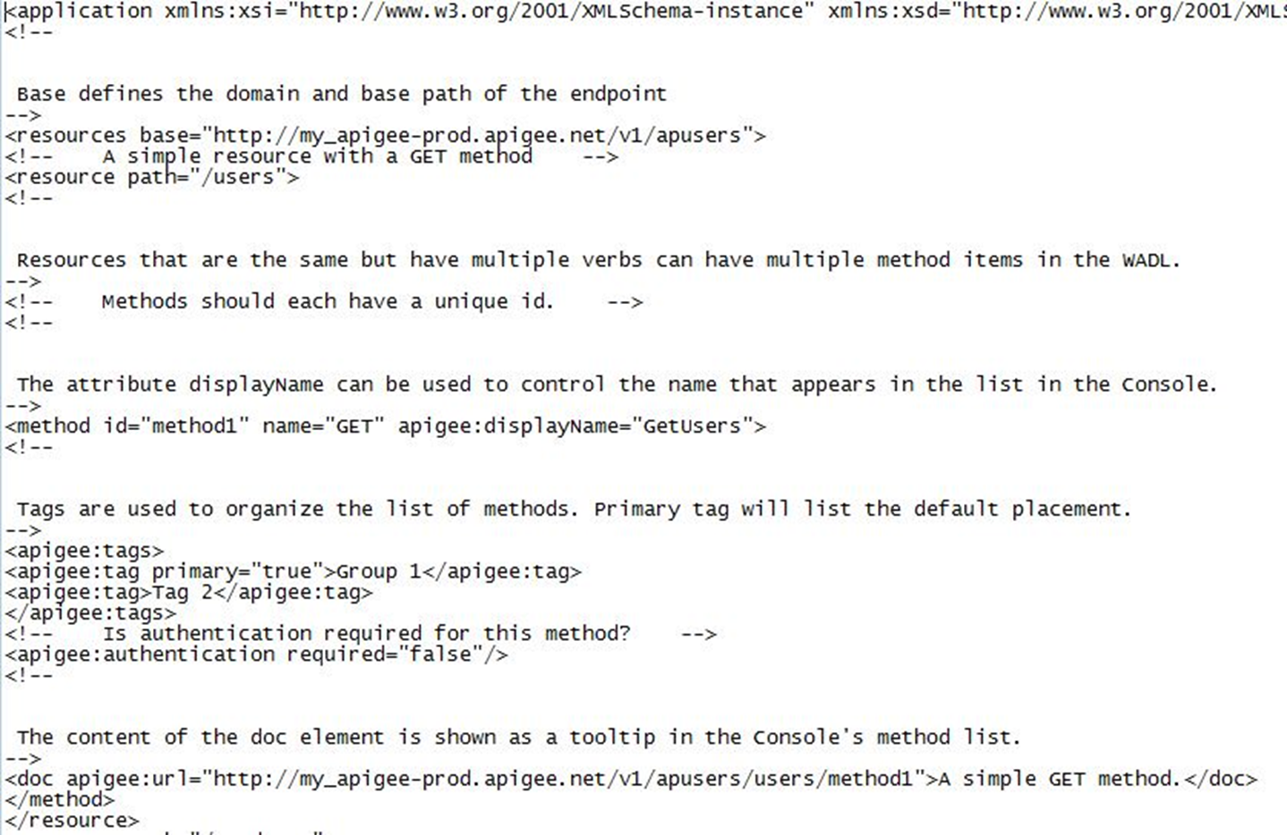
Creating WADL – API Methods

Slide 146
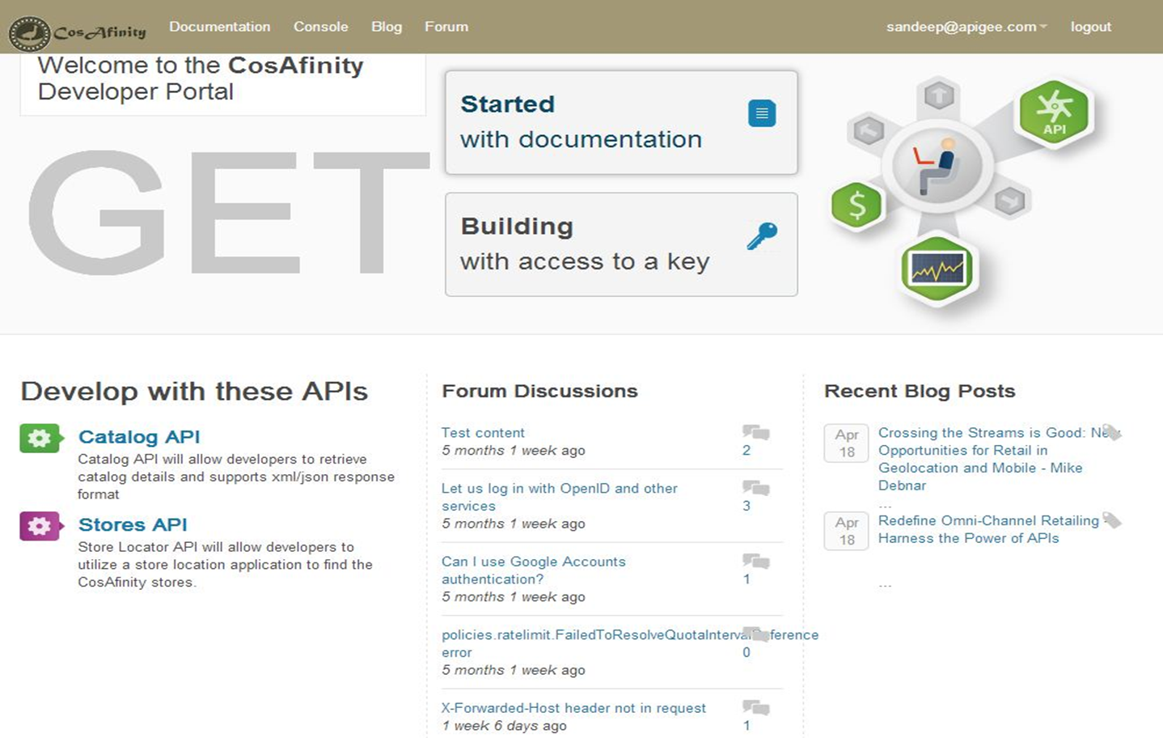
Developer Portal - Presales pool

Slide 147
Reference
http://apigee.com/docs/api-platform/content/optimize-performance-using-cache

Slide 148
Thank you

